Slide 1

Assignment Ch 3
Building a Data Ingestion Pipeline with Apache Sqoop, Flume, and Kafka on a Local Machine

Slide 2
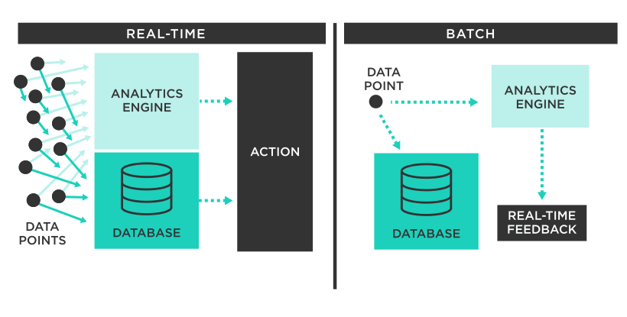
Objectives
Design a data pipeline that integrates batch processing.
Implement real-time streaming capabilities.

Slide 3
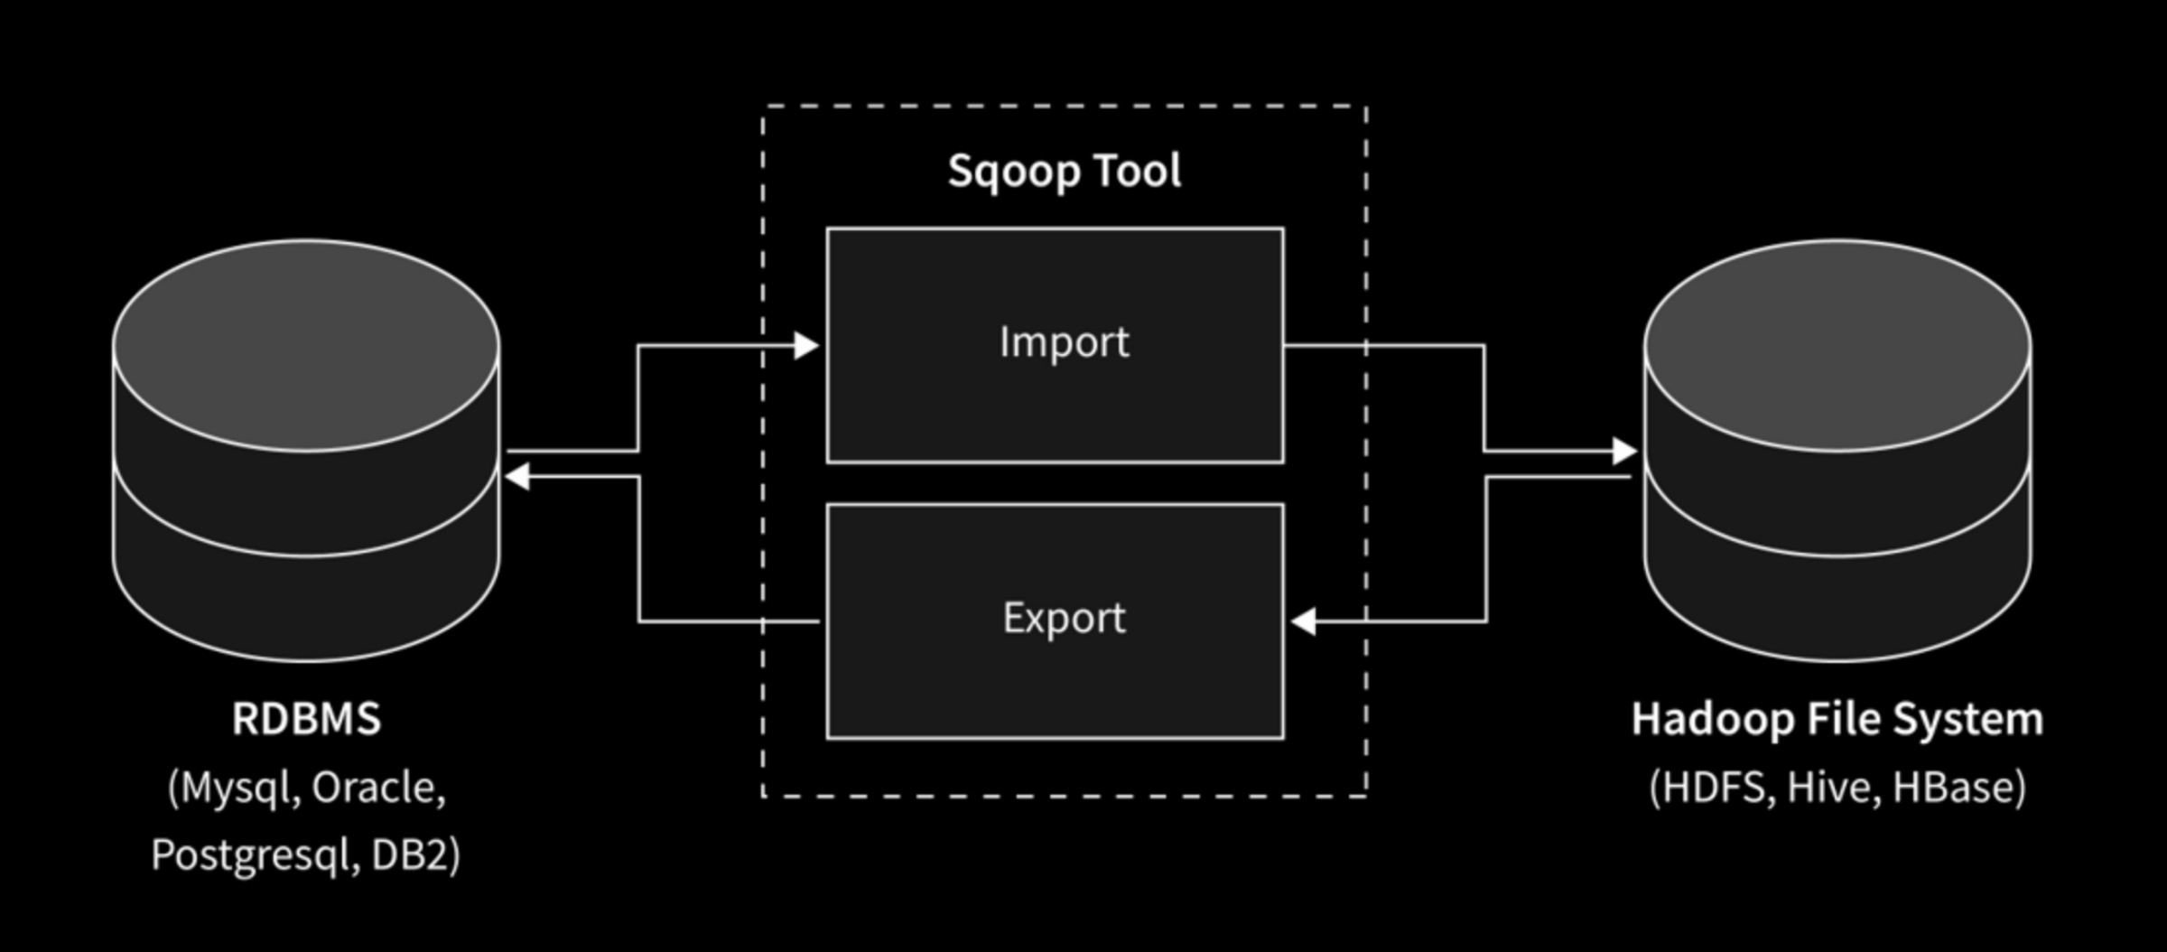
Scenario
This scenario demonstrates the migration of historical data from MySQL to HDFS using Sqoop, while real-time data from local files is ingested using Flume and managed by Kafka.

Slide 4





Component Descriptions
HDFS (Hadoop Distributed File System): Distributed storage system that stores and manages large datasets across multiple machines.
MariaDB: An open-source relational database management system that is a fork of MySQL, used for managing and storing structured data with enhanced performance and features.
Apache Sqoop: Batch data migration from relational databases to HDFS.
Apache Flume: Real-time data ingestion from local files to Kafka.
Apache Kafka: Manages real-time data streams and ensures seamless data flow.

Slide 5
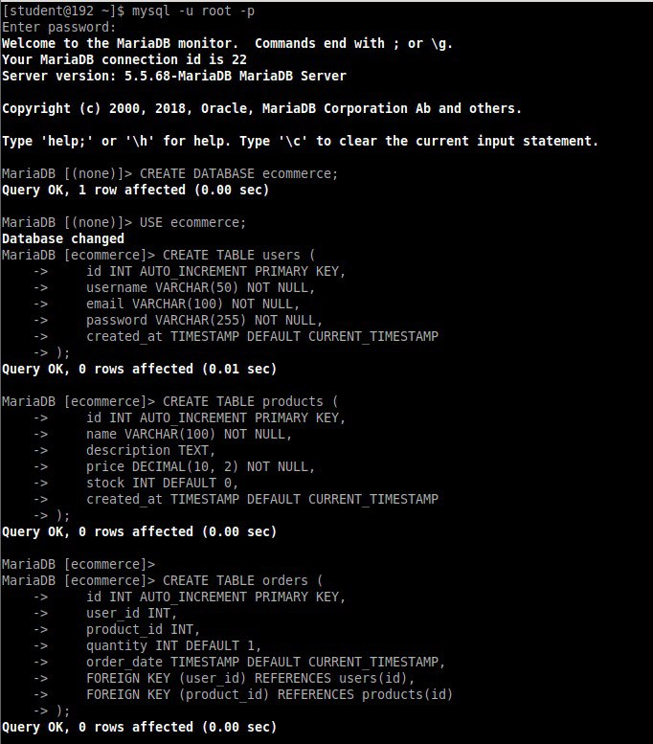
Setting Up an E-commerce Database
mysql –u root –p
Connecting to MariaDB: Logged into the MariaDB server using the mysql command.
CREATE DATABASE ecommerce;
Creating a new database named ecommerce to store all related data.
CREATE TABLE “..“
Users Table: Contains fields like id, username, email, password, and created_at.
Products Table: Contains fields such as id, name, description, price, stock, and created_at.
Orders Table: Contains fields like id, user_id, product_id, quantity, order_date, and foreign keys linking to users and products

Slide 6
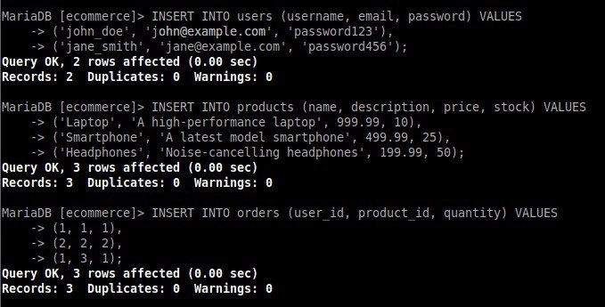
Data Insertion into E-commerce Database
Users: Added two users, John Doe and Jane Smith.
Products: Added three products: a laptop, a smartphone, and headphones.
Orders: Added three orders linking users to products with specified quantities.

Slide 7
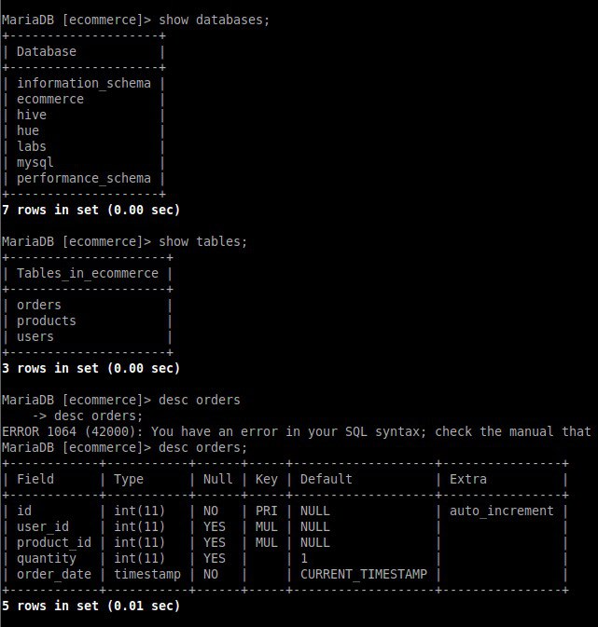
Viewing Database and Table Structure
SHOW DATABASES;
Listed available databases, including ecommerce, labs, and others.
SHOW TABLES;
Displayed tables within the ecommerce database: orders, products, and users.
DESC orders;
Displayed the describing and structure of the orders table, including fields like id, user_id, product_id, quantity, and order_date.

Slide 8
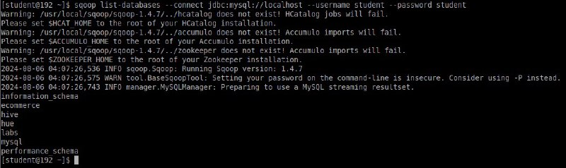
Listing Databases in MySQL Using Apache Sqoop
sqoop list-databases --connect jdbc:mysql://localhost --username student --password student
Connecting to MySQL Server: Sqoop will connect to the MySQL server running on localhost using the provided credentials.
Listing Databases: Sqoop will then retrieve and list all the databases that the student user has permission to access on the MySQL server.

Slide 9
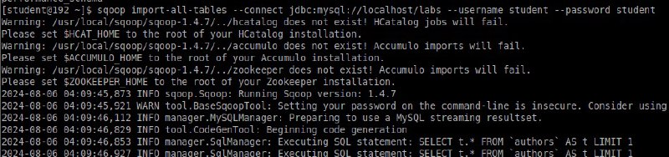
Importing All Tables from MySQL to Hadoop Using Sqoop
sqoop import-all-tables --connect jdbc:mysql://localhost/labs --username student --password student
Connecting to MySQL Database: Sqoop will connect to the MySQL server running on localhost and access the labs database using the credentials provided.
Importing All Tables: Sqoop will automatically detect all the tables present in the labs database and import them into (HDFS). Each table will be imported as a separate directory in HDFS.
Making it a convenient way to migrate an entire database into HDFS for further processing or analysis using Hadoop's ecosystem (e.g., MapReduce, Hive, etc.).

Slide 10
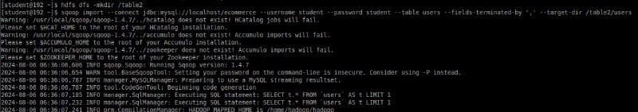
Creating a Directory in HDFS for Data Storage
hdfs dfs -mkdir /table2
Creates a directory in HDFS to hold the imported data.
sqoop import --connect jdbc:mysql://localhost/ecommerce --username student --password student --table users --fields-terminated-by ',' --target-dir /table2/users
Imports the users table from the ecommerce MySQL database into HDFS, placing the data in /table2/users and using a comma as the field delimiter.

Slide 11
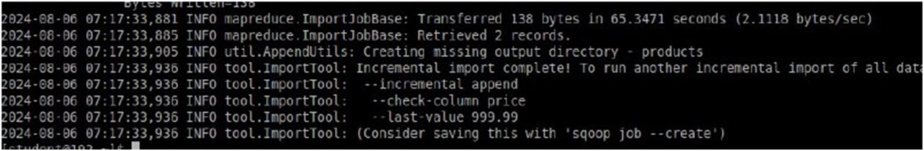
Incremental Import of Products Table into HDFS Using Sqoop
sqoop import --connect jdbc:mysql://localhost/ecommerce --username student --password student --table products --target-dir /user/student/table2 --incremental append --check-column price --last-value 999.99
Imports the products table from the ecommerce MySQL database into HDFS, storing the data in /user/student/table2.
Sqoop checks the price column to identify new or updated rows. It uses the --last-value of 999.99 to determine which rows are new or have changed since the last import. The imported data is appended to the existing data in the target HDFS directory, preserving previously imported rows.
After Insert New Data: The results show that data was transferred Successfully (138 bytes and 2 records) as part of this process.

Slide 12
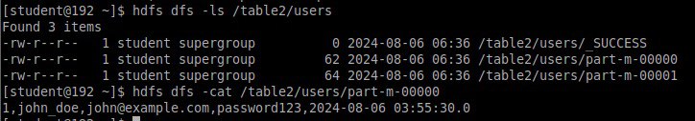
Viewing and Listing Imported Files in HDFS
hdfs dfs -ls /table2/users
Lists files in the /table2/users directory. The output includes:
SUCCESS: Indicates that the data import job was completed successfully.
part-m-00000, part-m-00001: These are data files generated by the import job. Each file contains a portion of the imported data.
hdfs dfs -cat /table2/users/part-m-00000
Displays the content of the file part-m-00000. This file contains user data with fields such as id, name, email, password, and timestamp, showing the details of the imported records.

Slide 13
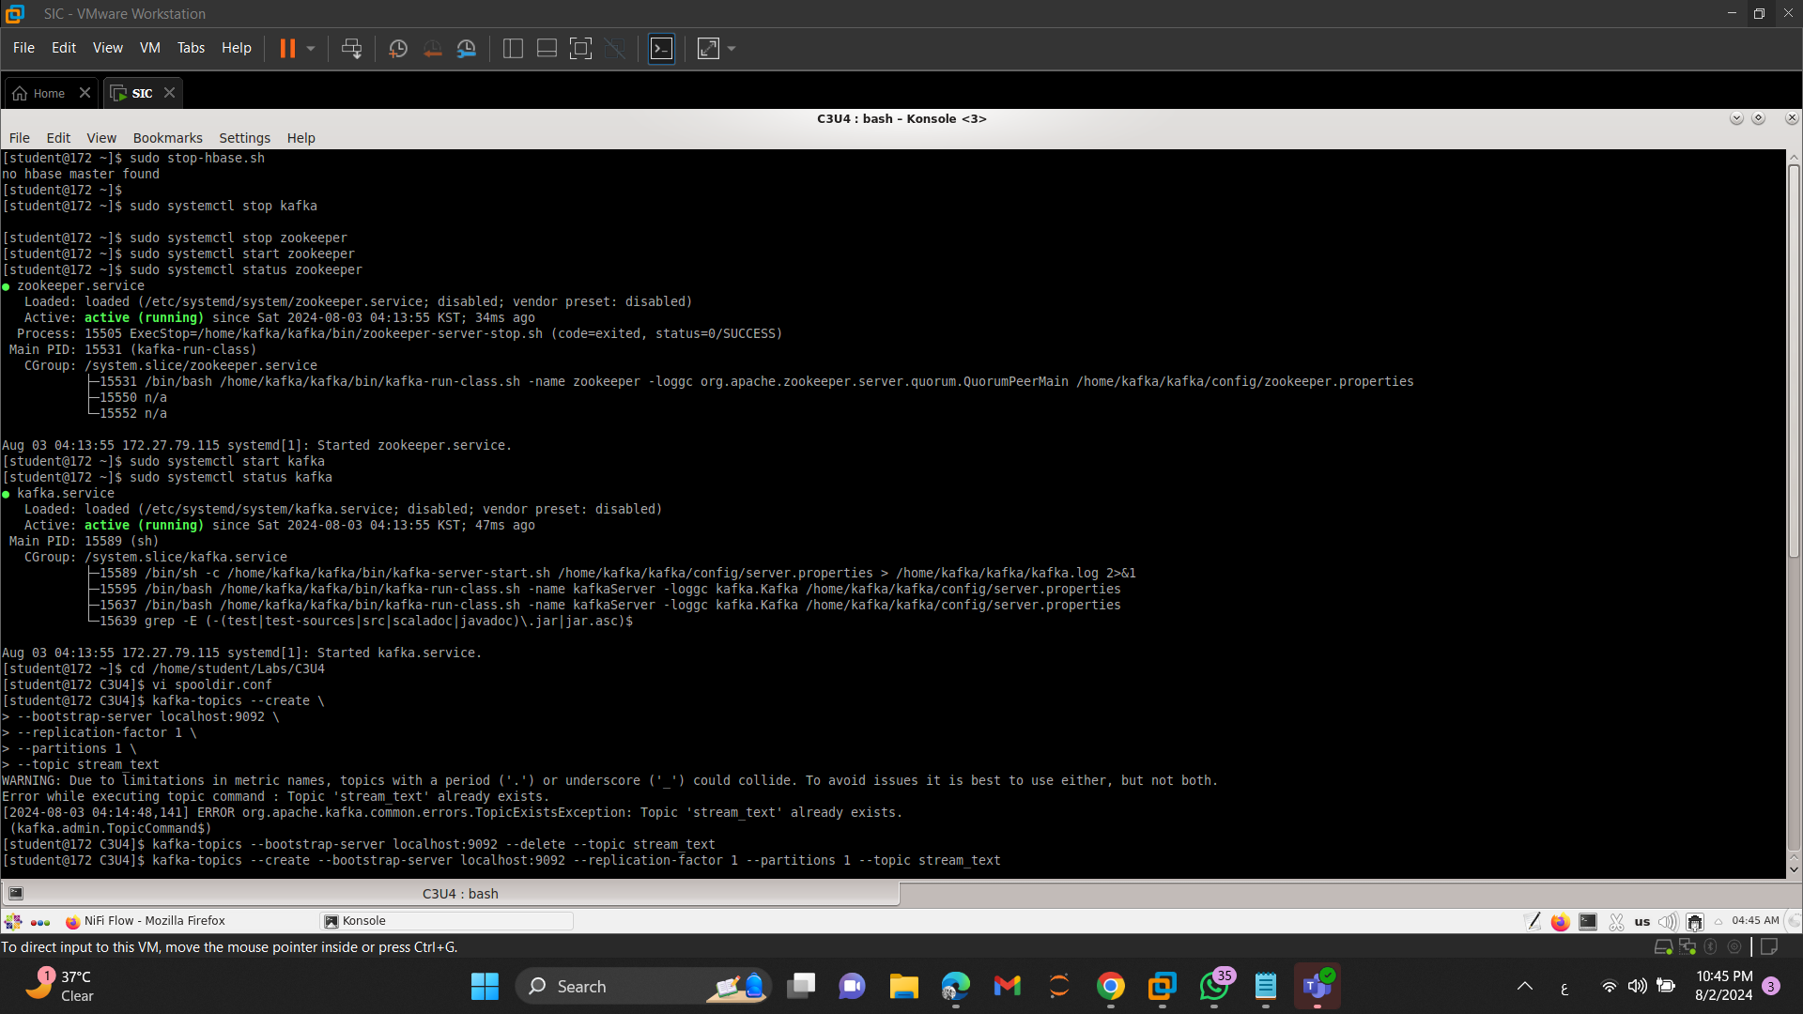
Managing Zookeeper and Kafka Services
These commands are typically used to ensure that both Zookeeper and Kafka services are running correctly, which is essential for managing distributed systems and real-time data processing.

Slide 14
Preparing Kafka Environment
cd /home/student/Labs/C3U4
Changes the current working directory to ensure that any subsequent commands are executed in the correct directory, where the relevant files and configurations are located.
vi spooldir.conf
Opening this file using vi editor allows to view or edit the configuration settings related to Kafka setup
kafka-topics --create --bootstrap-server localhost:9092 --replication-factor 1 --partitions 1 --topic stream_text
Creates a new Kafka topic named “stream_text”, and with specific settings for partitions and replication, preparing Kafka to handle streaming data.

Slide 15
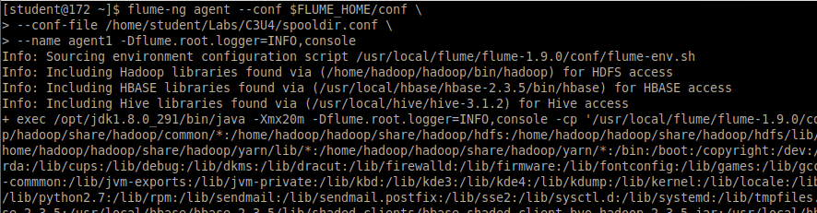
Starting a Flume Agent
flume-ng agent --conf $FLUME_HOME/conf --conf-file /home/student/Labs/C3U4/spooldir.conf --name agent1 -Dflume.root.logger=INFO,console
Starts a Flume agent to handle data ingestion and transport according to the configuration in “spooldir.conf”. It configures the agent with specific parameters, including data sources, sinks, and channels, and sets up logging for monitoring its operations.

Slide 16
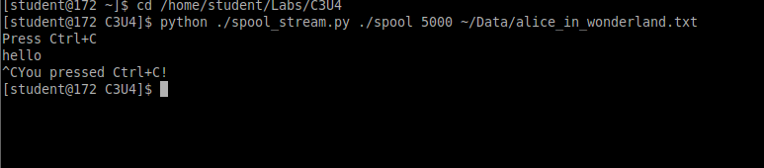
Running a Python Script and Navigating Directories
python ./spool_stream.py ./spool 5000 ~/Data/alice_in_wonderland.txt
Navigates to the directory where the Python script “spool_stream.py” located.
python ./spool_stream.py ./spool 5000 ~/Data/alice_in_wonderland.txt
The Python script processes a text file “alice_in_wonderland.txt”, potentially for tasks like streaming or spooling data to a designated directory (./spool) with specific settings (e.g., 5000 as a parameter). This setup is often part of a data pipeline or processing system where the script handles data ingestion or manipulation based on the provided inputs.

Slide 17
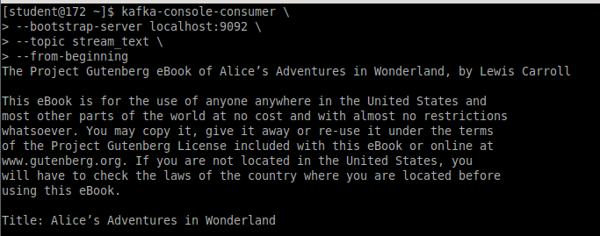
Consuming Kafka Streams with Kafka Console Consumer
kafka-console-consumer --bootstrap-server localhost:9092 --topic stream_text --from-beginning
Consumes and displays messages from the beginning of the Kafka topic “stream_text”. starting from the earliest available message. This is useful for debugging or for reviewing the complete message history of the topic from the start.

Slide 18
Conclusion
Recap
Thus, a data ingestion pipeline was built that handles both batch processing using Apache Sqoop and real-time streaming using Apache Flume and Kafka. The pipeline successfully moved historical data from a MySQL database to HDFS and streamed live data.
Key Accomplishments
Database Setup: We designed an e-commerce database and inserted sample data, ensuring a comprehensive structure for user, product, and order information.
Batch Data Migration: We used Sqoop to transfer data from MySQL to HDFS, demonstrating our ability to efficiently manage data transfers.
Real-Time Data Streaming: Implemented a real-time data streaming process using Flume and Kafka, showing that our pipeline can handle real-time information.

